Slide 1

MILESTONE 1: Planning and Proposal
Project Name: RCCG Website
By: Iyanu Lamina

Slide 2
About The website
This project involves the development of a website for clients, providing users with the ability to access information about the organization. The website will feature sections such as the About page (highlighting services), mission and vision, events, anthem, contact details, beliefs, photos, location, prayer line, and more. Specifically, the website will include: About Page: Detailing the organization's services. Mission and Vision: Outlining the purpose and goals. Contact Information: Including contact details, location, and a dedicated prayer line. Services: Information about days and times of operation (to be included in the footer). Photos: Visual representation of events and activities. Anthem: Featuring the organization's anthem. Admin Panel: Providing administrators with the ability to create accounts and manage updates, edits, and deletions. The footer will contain essential information such as contact details, location, prayer line, and service schedule. The admin panel will facilitate account creation and enable seamless updating, editing, and deletion of content."

Slide 3
Project SUmmary
Purpose of the website
It is a means of informing the community about the activities of the church and facilitating outreach efforts to invite people to attend services. The primary purpose of the website is to serve as a platform where members of the organization and other potential users can access information about the church. Additionally, it will offer updates from the organization to keep potential users informed. Moreover, the website is designed to provide new users with the necessary information and guidance on how to locate the church when needed.
Problem it addresses
We are aware that some individuals are unable to attend church physically, and we aim to share the word of God with them primarily through our online services, hosted on social media platforms such as Facebook. Our website serves as a portal to connect people with the church and provide regular updates. It offers valuable information for both the congregation and the public. Additionally, the website facilitates online donations. What sets it apart from other church websites is our plan to track attendance for each member. This allows us to foster a sense of community, enabling everyone to recognize each other and providing an avenue to reach out to those who couldn't attend church on a particular Sunday."
Why is the project important; Why is it relevant:
It facilitates keeping church members informed and up-to-date. By sharing information with the public, it contributes to the growth of our membership. Additionally, funds generated from/through the website will be used to support various church initiatives. It serves as a platform to communicate our vision to the public.
Who could your project help; who is your audience, stakeholder, or customer:
Our stakeholders include the congregation and potential members, as well as believers in Christ who are seeking a church but have not yet found one, and the general public. This project aims to benefit these groups of people.

Slide 4
Functional Requirement
1.1 | The system shall allow the user to make a call.
1.2 | The system shall allow users to browse freely on the site (friendly user interface).
1.3 | The system shall give the user access to send a message to the client.
1.4 | The system shall allow users to view updates.
1.5 | The system shall make communication possible between the organization and users.
1.6 | The system shall allow users to make payments or give funds when necessary.
1.7 | The system shall send or decline a message.

Slide 5
non-functional requirement
1.1 | The system shall allow the website to be accessible on various devices.
1.2 | The system shall ensure that the user's information is secure and has access to the website 24/7.
1.3 | The system shall provide users with weekly updates.
1.4 | The system shall notify the organization 2 mins after the email is sent.
1.5 | The system shall send an email to the user 2 secs after the organization's response.

Slide 6
User stories
(User Story 1): Mayowa is a diligent student who faithfully attends church services throughout the week and on Sundays. One day, she wanted to connect with someone from the church but realized she didn't have their contact information. To remedy this, she decided to search for the church website online. Upon finding the website, she discovered that it lacked any contact details. Determined to reach out, Mayowa resolved to inquire about the church's contact information from the pastor or another church executive during Sunday service. She expressed hope that the church would update its website to include essential information, such as a contact form.
(User Story 2): Glory is a member of a different denomination but learned about RCCG from one of her friends and expressed interest in attending. She decided to visit the church the following Sunday. As she was searching for the church address on Sunday, she came across one address, but it turned out to be outdated and not the current location of the church. In response, she reached out to her friend to ask for the correct address. After receiving all the details from her friend, she compared it with the address she initially found on the website, realizing they were entirely different. She hopes that the church can update its location to help potential members easily locate it in the future.

Slide 7
USER STORY (Cont’d)
(User Story 3): Andrea, a mother of three who had previously attended RCCG, was determined to continue being part of this church, regardless of her family's location. When she was transferred to a different branch of her company in Moorhead, MN, she took the initiative to reach out to the church online. After finding a phone number, Andrea called to inform the church that her family would be moving to Moorhead and expressed their desire to be part of the church community.
Following a conversation with one of the church executives, Andrea decided to explore the church's website. During her review, she noticed that the website lacked some information compared to her previous church. Hoping for an improvement, she suggested that the church update the website by adding the necessary information and making it more user-friendly.
(User Story 4): David serves as an assistant pastor at his church. During a visit to his parents' place, he decided to attend a local church before returning home. While uncertain about which church to attend, he was discerning and didn't want to choose just any church. Seeking guidance through prayer, the Holy Spirit led him to RCCG.
On Sunday, Daniel followed the Holy Spirit's guidance and searched for RCCG online. He found their website and, using the provided address, successfully attended the church service that Sunday. Navigating to the church was easy for Daniel, as he found all the necessary information on the website. However, during his search, he noticed that the church webpage lacked a donation feature. Consequently, he suggested adding this functionality in their website update.

Slide 8
use-case scenarios 1
Initial Assumption: A user browses the website to discover all the details about the church and contact them. The user is pleased and can contact the church through messaging or a phone call.
Normal: Users should be able to access the contact information whenever they browse the web. The user should have the option to choose whether they want to call or send a message. When a user makes a phone call or sends a message, they should receive a response within 24 hours.
What can go wrong: When a user sends a message, there may be a delay in receiving a response. Similarly, when a user makes a phone call, there may be instances where no one is available to answer, depending on the time the call was placed. Also, while trying to place the call, the number in question might be outdated or not in use.
Other activities: The website might be lacking contact details on there website which can make it difficult for users to reach the administration. The administration can decline the call because they are assigned an important task and need to focus.
System state on completion: The user can place calls and send messages. The users get responses for both phone calls and messages. They can navigate through the website effortlessly and locate all the required information. The user is happy and satisfied.

Slide 9
use-case scenarios 2
Initial Assumption: A user browses through the website and finds the address of the church. church. The user copies the address and then proceeds to go to church in person. Additionally, the user has the option to click on the available link to watch the online service.
Normal: Users should be able to access the church details on the website. The user should have the option to choose whether they want to attend Sunday service in person or virtually. Having done that, the church location should be visible to the user whenever they browse through the web. Users should have access to the online service link and can watch the Sunday service online without any obstruction.
What can go wrong: While the user is watching the online service, they might experience slow internet service or face difficulties hearing the church due to loud noises or poor internet connectivity on the church's end. If the user chooses to attend church in person, the church address or location might be outdated, or they might post the wrong time for service.
Other activities: Unknown
System state on completion: They can navigate through the website effortlessly and locate all the required information. The online service is excellent; the internet connection is perfect, and there is minimal noise interference during the online session. The user can hear clearly and is satisfied.

Slide 10
USE case scenario 3
Initial Assumption: A user browses the website to discover all the details about the church. The users go through all the available web pages. The user contacted the church via email or by phone. The church administrators accept or decline the call.
Normal: Browsing the church website should be a seamless experience for users. As they navigate through various pages, they should be provided with the option to either make a call or send an email to the church administration. Upon comparison with the user's previous church website, slight differences should be evident. The user anticipates user-friendly enhancements and wishes for the inclusion of more important pages to improve overall functionality. The user wants the church to have pages like the attendance page.
What can go wrong: When a user sends a message, there may be a delay in receiving a response. Similarly, when a user makes a phone call, there may be instances where no one is available to answer, depending on the time the call was placed. Likewise, the user might be experiencing issues uploading files.
Other activities: When attempting to record attendance for the congregation, users may encounter issues while trying to upload or mark an individual as present. If the user is attempting to upload a file, they may also encounter an error if the file size exceeds the limit.
System state on completion: They can navigate through the website effortlessly and locate all the required information. The user can upload all the necessary files. Updates are made and the user is happy.

Slide 11
USE case scenario 4
Initial Assumption: The user is logged in and can access the website. The user scrolls through each page and likes all the features. The user is looking for a donation feature to make donation to the church.
Normal: Users should be able to access the church details on the website. The user should have the option to choose whether they want to call or send a message. The church location should be clearly visible to the user. Users should have access to the online service link and can watch the Sunday service online without any obstruction. When a user makes a phone call or sends a message, they should receive a response within 24 hours.
What can go wrong: When it comes to making payments, users may encounter issues while trying to make payments and this could be as a result of poor internet connection or other unforeseen issues. Website might not be secure which can put the user at risk.
Other activities: Certain payment types might not be accepted.
System state on completion: The user can successfully make payments for donations without any issues. The online service is excellent; the internet connection is perfect, and the user is satisfied.

Slide 12
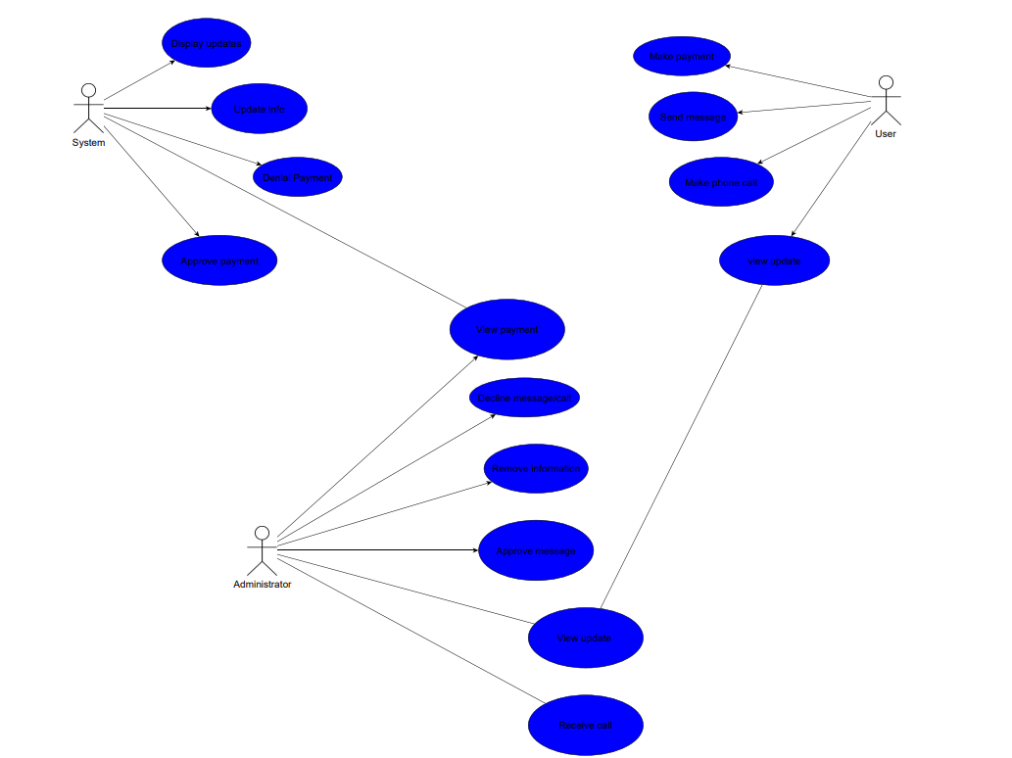
USE CASE Diagram

Slide 13
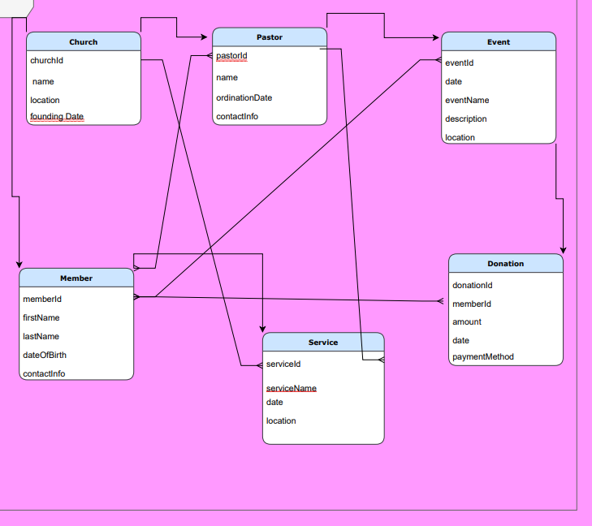
Database structure

Slide 14
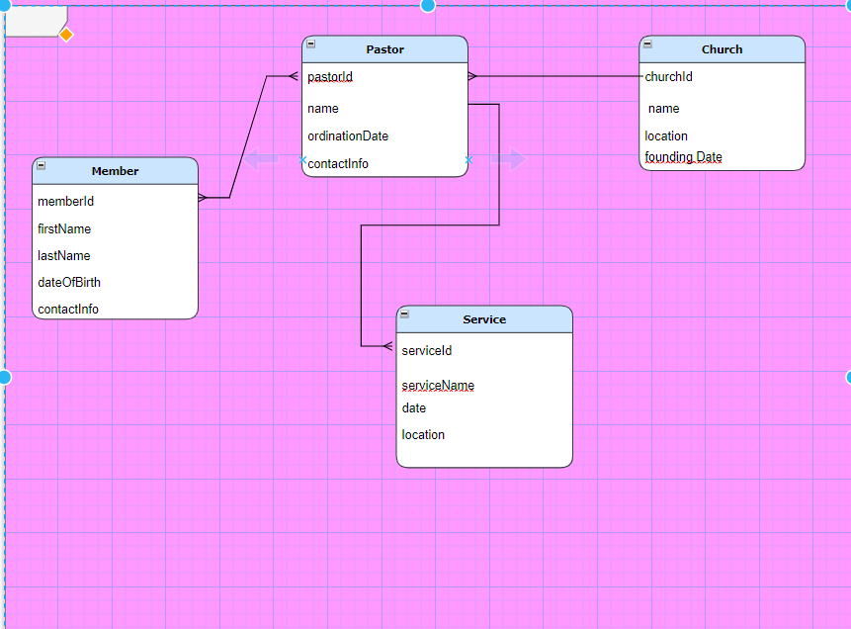
Pastor –To other relations

Slide 15
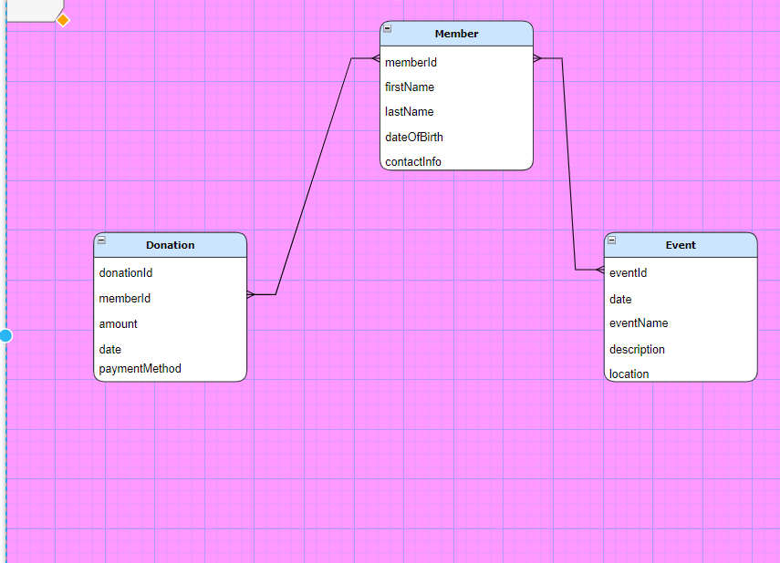
Members –To other Relations

Slide 16
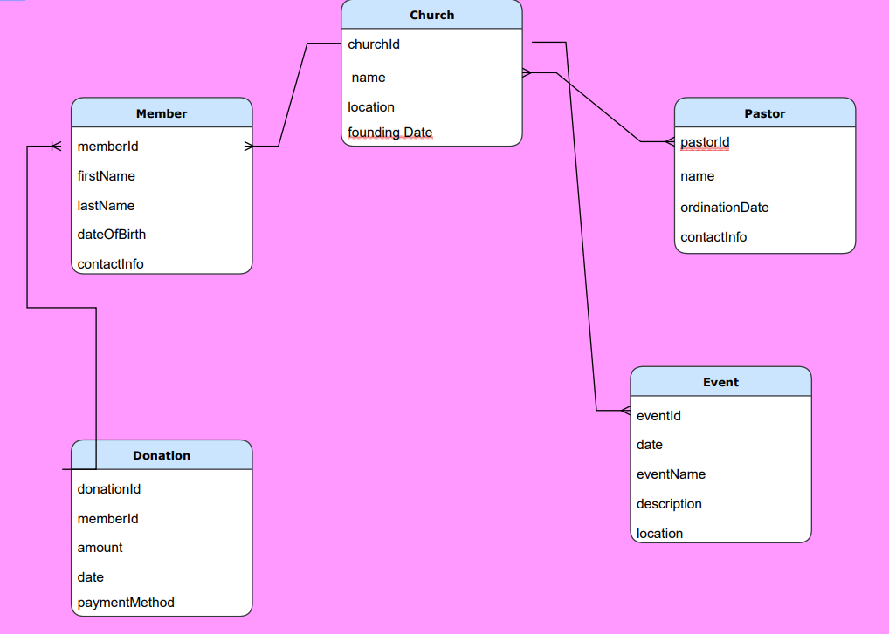
Church- To other relations

Slide 17
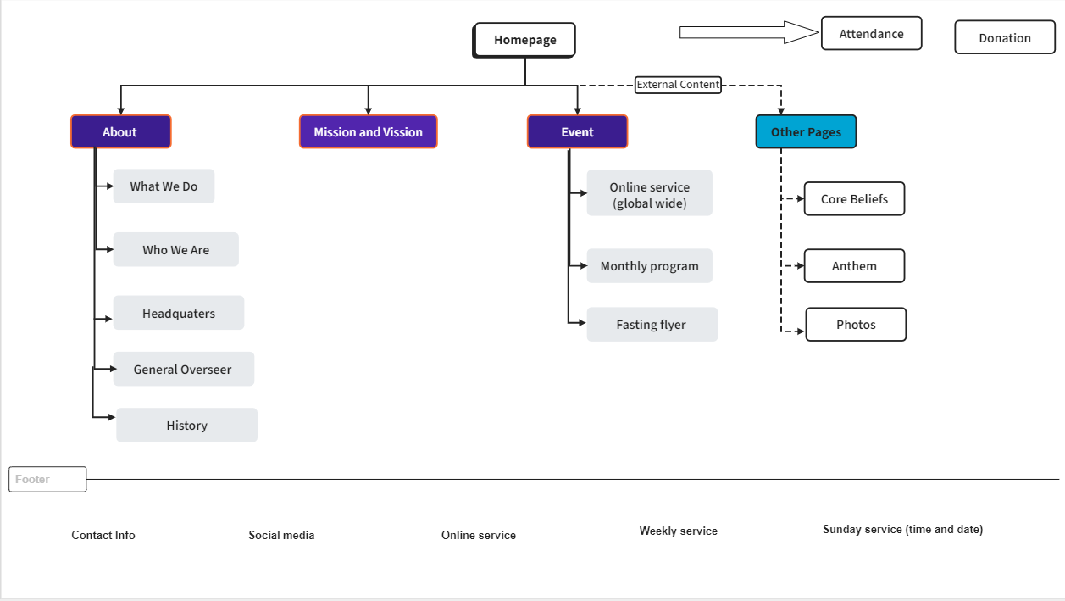
SITE MAP

Slide 18
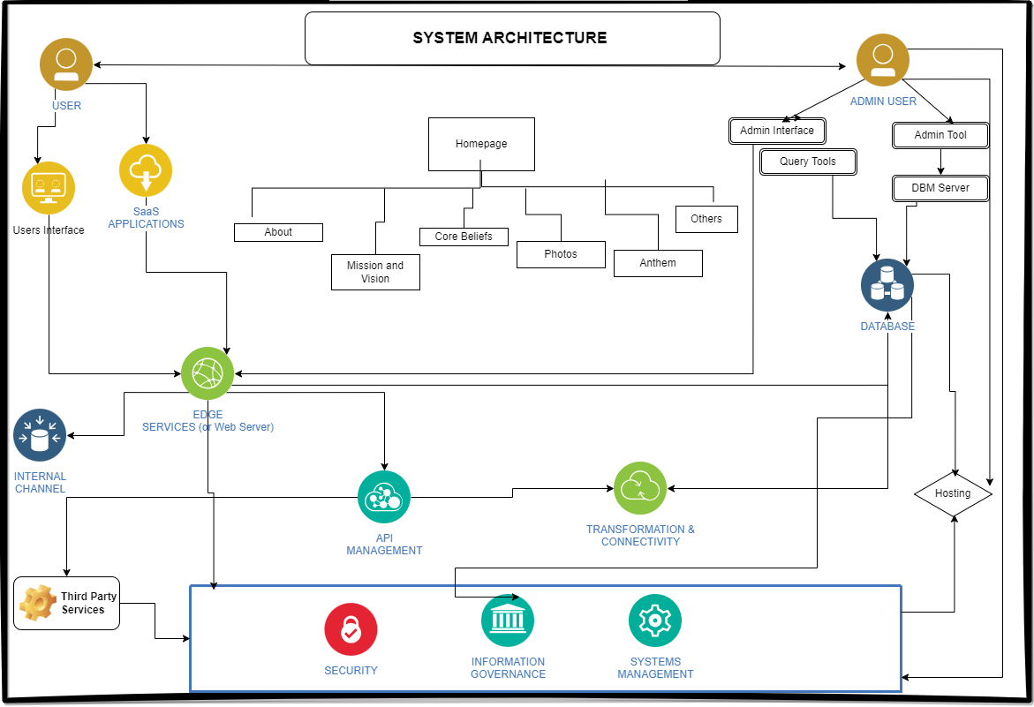
System Architecture

Slide 19
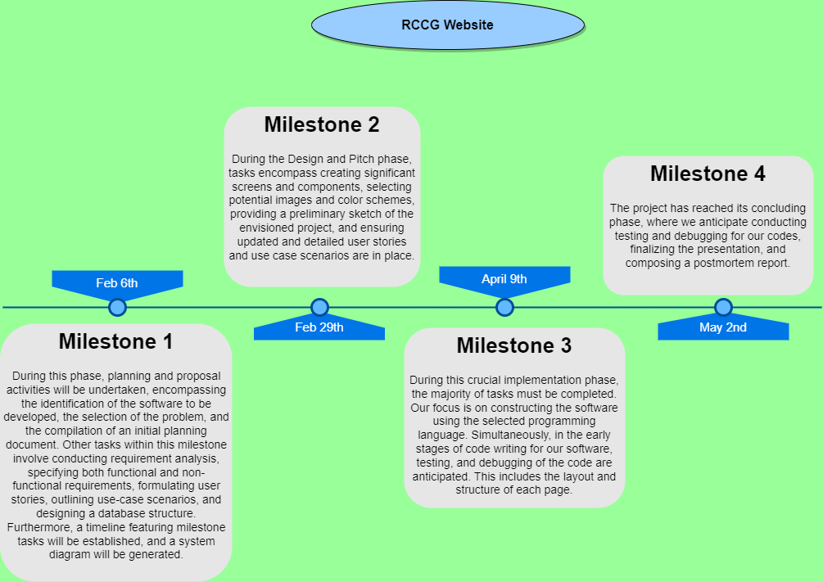
MILESTONE TIMELINE

Slide 20
GANTT CAHRT (TASK and estimate)
Project Timeline (Gantt Chart).xlsx (sharepoint.com)

Slide 21

THANK YOU

